Slide 1
Formal Methods in Software Engineering
Lecture # 4-5

Slide 2
Recap
Formal Methods
Rigorous mathematically-based techniques and tools for the specification, development, and verification of software and hardware systems.
Software Development
The process by which user needs are translated into a software product. This involves translating user needs into software requirements, transforming the software requirements into design, implementing the design in code, and testing the code¹.

Slide 3
Propositional Formula
In propositional logic, a propositional formula is a type of syntactic formula which is well formed and has a truth value. If the values of all variables in a propositional formula are given, it determines a unique truth value. A propositional formula may also be called a propositional expression, a sentence, or a sentential formula.

Slide 4
Propositional Formula
A propositional formula is constructed from simple propositions, such as "five is greater than three" or propositional variables such as P and Q, using connectives such as NOT, AND, OR, or IMPLIES; for example:
(P AND NOT Q) IMPLIES (P OR Q).

Slide 5
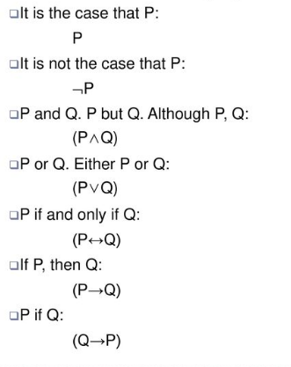
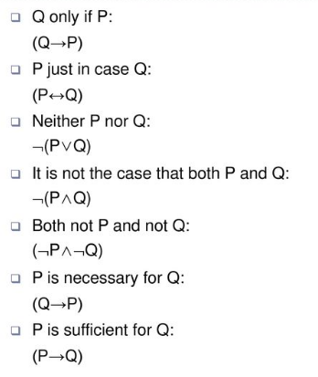
Formalize Natural Language

Slide 6
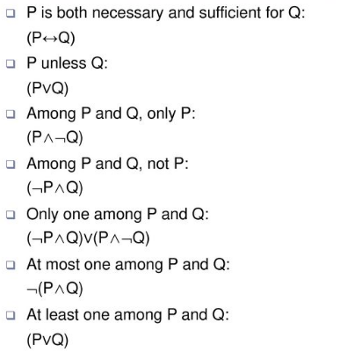
Formalize Natural Language

Slide 7
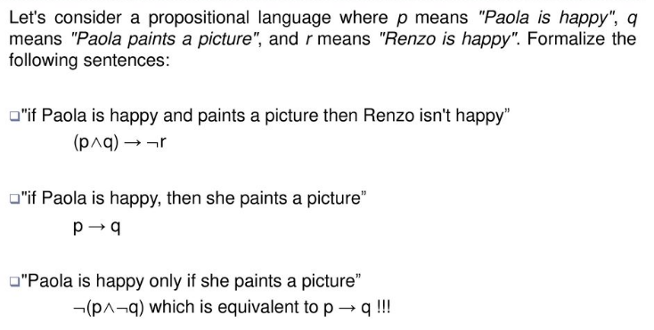
Formalize Natural Language

Slide 8
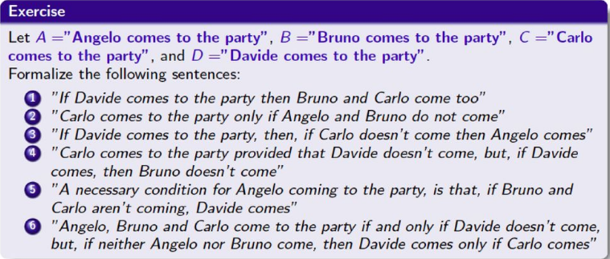
Formalize Natural Language

Slide 9
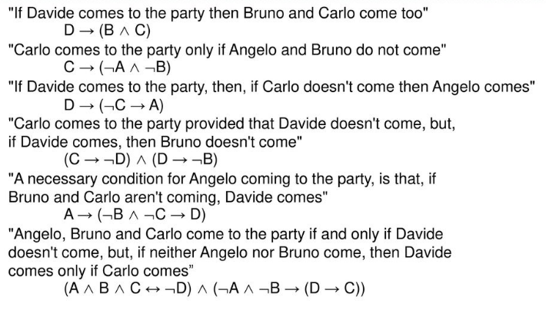
Formalize Natural Language

Slide 10
Tautology (1)
A tautology is a statement that is always true, no matter what.
If you construct a truth table for a statement and all of the column values for the statement are true (T), then the statement is a tautology because it's always true!

Slide 11
Tautology (2)
If you are given a statement and want to determine if it is a tautology, then all you need to do is construct a truth table for the statement and look at the truth values in the final column. If all of the values are T (for true), then the statement is a tautology.

Slide 12
Tautology (3)
'I will either get paid or not get paid‘
we can use p to represent the statement 'I will get paid' and
¬p to represent 'I will not get paid.‘ or it is not the case that I will get paid
It concludes to following form
p V ¬p

Slide 13

Tautology (4)
Truth table for the previous relation is

Slide 14
Contradiction (1)
A compound statement is a contradiction if it is false regardless of the truth values assigned to it

Slide 15
Contingency (1)
A proposition that is neither a tautology nor a contradiction is called a contingency
A relation that have both T & F values

Slide 16
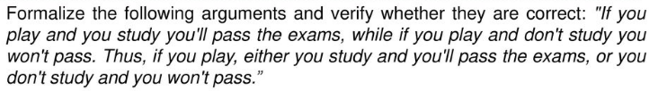
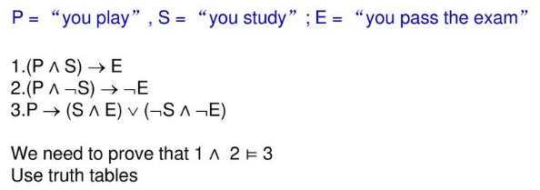
Problem

Slide 17
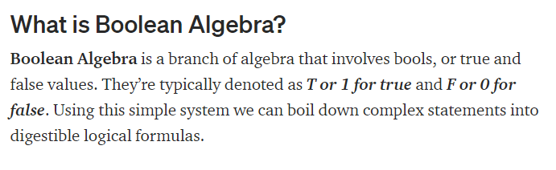
Revision

Slide 18
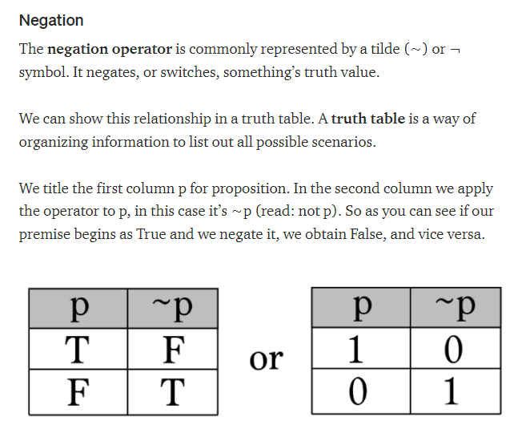
Revision

Slide 19
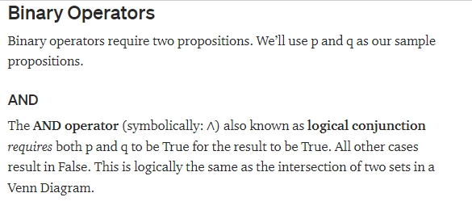
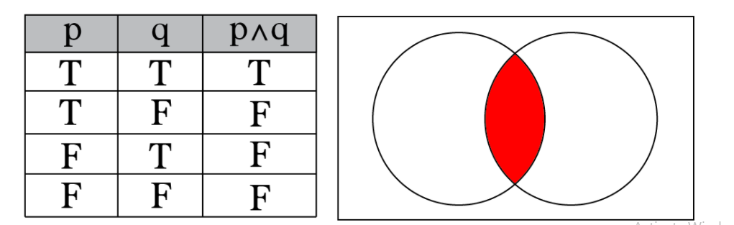
Revision

Slide 20
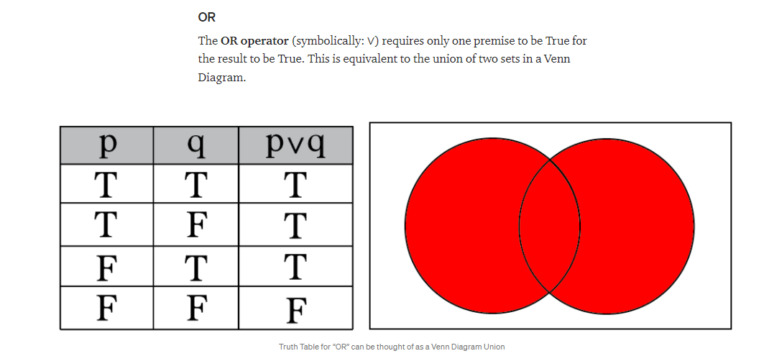
Revision

Slide 21
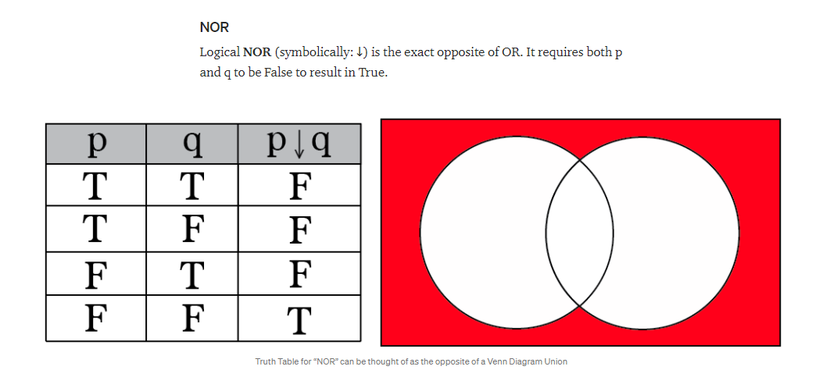
Revision

Slide 22
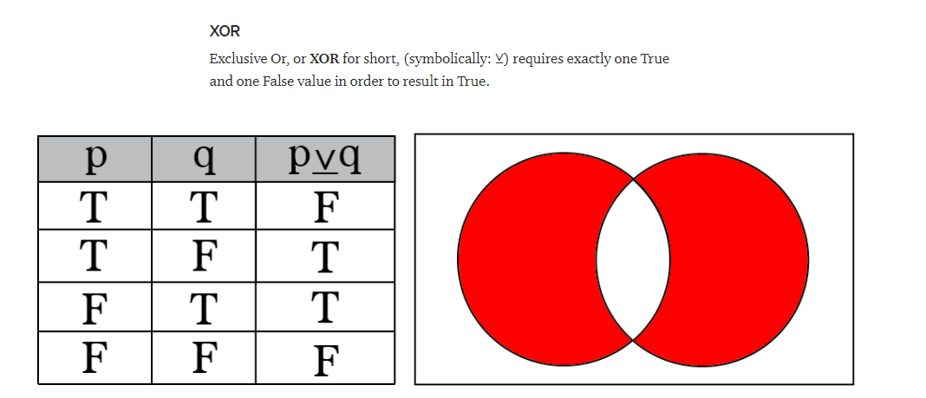
XOR

Slide 23
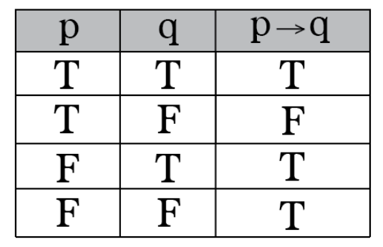
Implication Truthtable

Slide 24
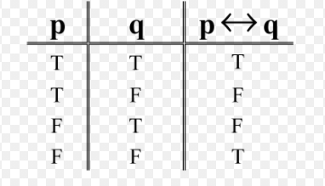
Equivalence Truthtable

Slide 25
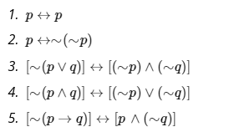

Class Activity

